Slide 1
Courier Delivery and route tracking
(Group no 22)
Student Name :YVVN.Varshita Chowdary Roll No:2620030614
Student Name :Samba Yashaswini Roll No:2620030299

Slide 2
Abstract
The Courier Delivery Route and Tracking System optimizes parcel logistics to make courier management faster, more organized, and reliable. The system helps delivery personnel locate efficient paths to multiple destinations, reducing travel time and operational delays. It provides real-time tracking, allowing customers to monitor package location and transit status instantly. By using route optimization and live tracking, the system connects customers, couriers, and administrators through a single platform to improve overall delivery efficiency.

Slide 3
Understanding Problem Statement
Processing Bottlenecks: Slow manual logs and high data matching errors in traditional hubs.
Visibility Deficit: Customer delivery anxiety due to missing real-time shipment updates.
Storage Hurdles: Inability to track vacant storage spaces dynamically inside sorting bays.
Solution: A compact Java program to book parcels, map grid spaces, and handle errors.

Slide 4
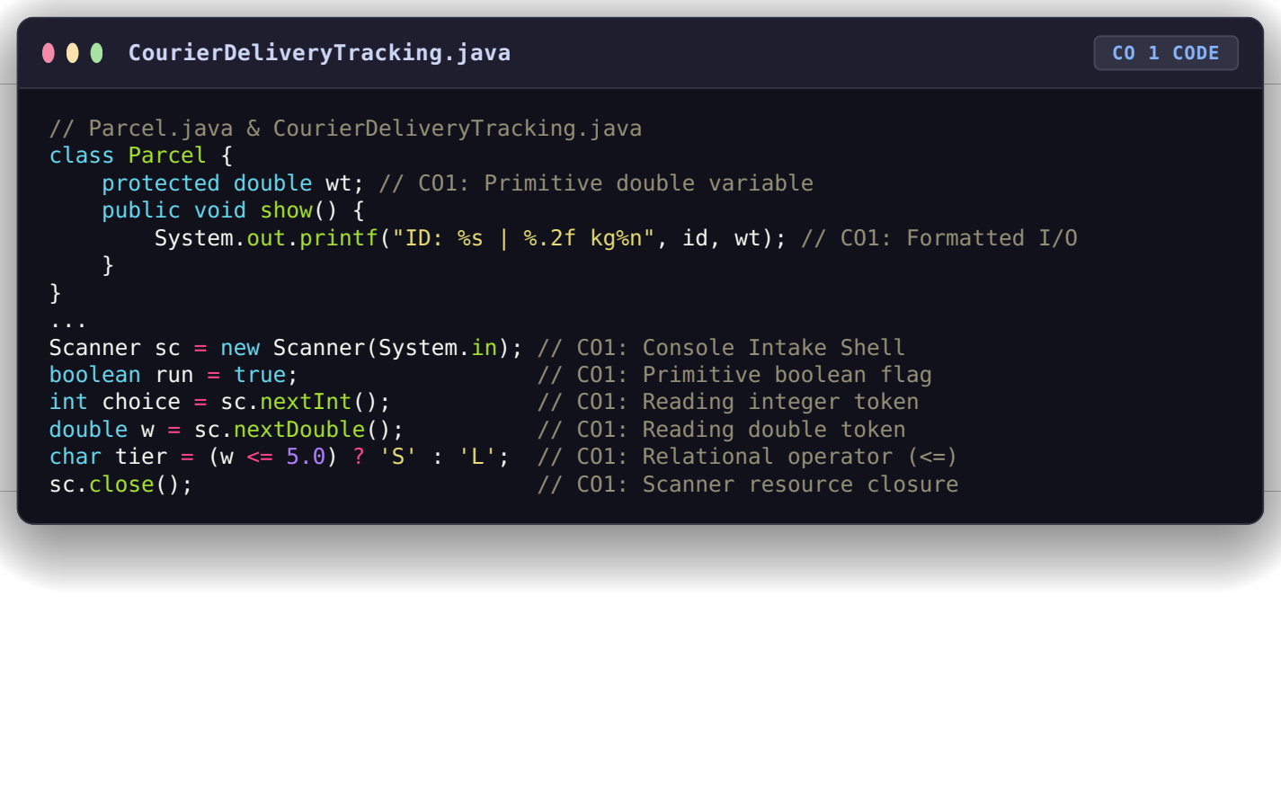
CO 1 Topics
Primitive Datatypes: Allocated double weight for precise package weight and char tier for locker sizes to minimize layout overhead.
Console Intake Shell: Initialized a centralized Scanner instance to pull keyboard tokens dynamically.
Relational Math Operators: Implemented logical inequality checking signs (<=, <, ==) to validate package data boundaries.
Formatted Console I/O: Leveraged standard System.out.printf() with %s, %.2f, and %n to print aligned receipts.
Variables:To track parcel details (Id,Weight), control loops and choices (run, choice), and temporarily hold user inputs

Slide 5
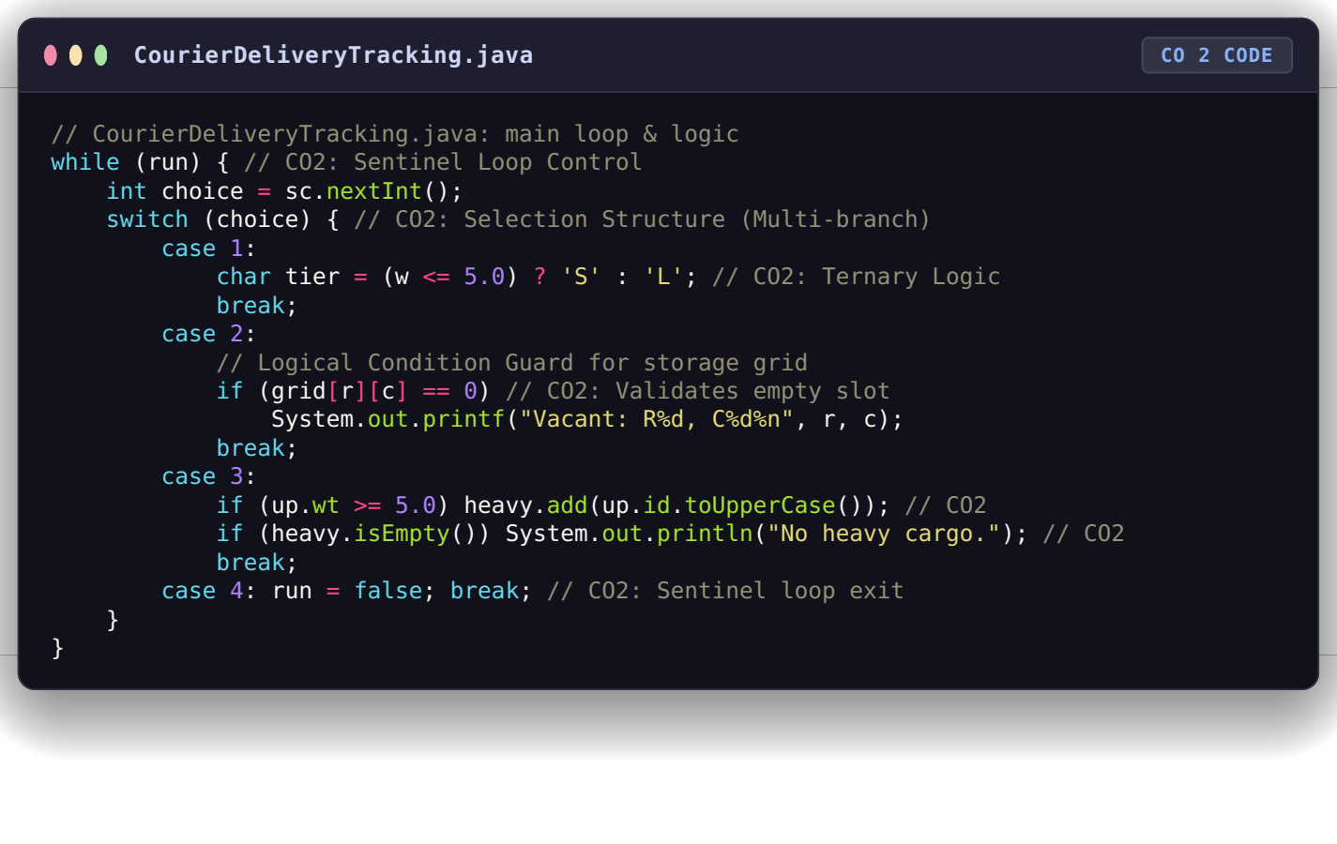
Co 2 TOPICS
Sentinel Loop Control: System loops continuously via while (run) to handle multiple orders.
Selection Structure: Standard structured switch configuration handled via switch (choice).
Ternary Logic Engine: Conditional selection tracking shorthand: char tier = (w <= 5.0) ? 'S' : 'L';.
Logical Condition Guards: Validates empty grid slots via if (grid[r][c] == 0).

Slide 6
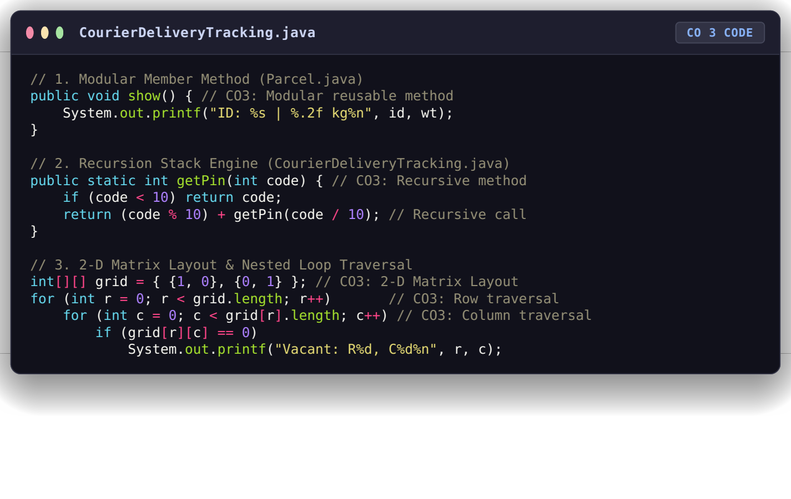
CO 3 Topics
Modular Methods: Separated tracking actions out into clear, reusable member methods (show()).
Recursion Stack Engine: Programmed a self-invoking method (getPin()) that breaks down values mathematically to calculate a secure PIN token.
2-D Matrix Layout: Modeled physical warehouse storage slots directly as a multi-dimensional array grid (int[][] grid).
Nested Loop Traversal: Ran loops inside each other to scan coordinates row-by-row to isolate open storage bays automatically.

Slide 7
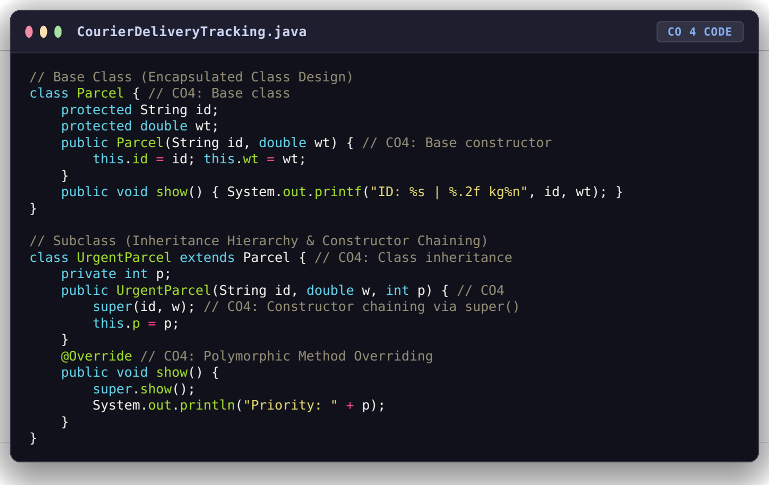
CO 4
Encapsulated Class Design: Core tracking variables are bundled safely inside class Parcel.
Class Inheritance Hierarchies: Specialized subclass relation created via class UrgentParcel extends Parcel.
Constructor Chaining Infrastructure: Reuses parent properties instantly inside subclass using super(id, w).
Polymorphic Method Overriding: Custom child printing behaviors verified safely via @Override.

Slide 8
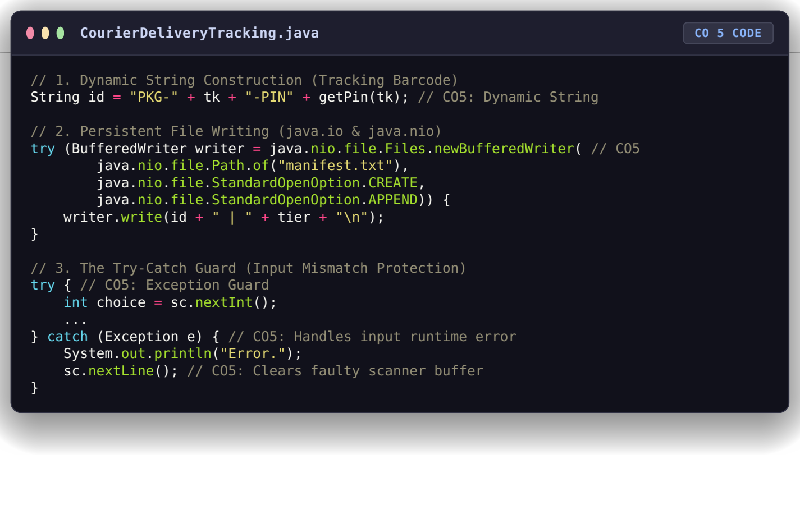
CO 5
Types of Strings Used:
  Static Strings: Fixed text literals used for terminal menus and labels (e.g., "\n1. Book | 2. Grid...").
  Dynamic Strings: Unique alphanumeric tracking codes (id) built at runtime by combining text blocks and numbers (e.g., "PKG-105-PIN6").
The Try-Catch Guard:
  Catches input runtime errors (like entering letters instead of a number).
  Clears the faulty scanner buffer using sc.nextLine() to prevent loop crashes.
Importance of Dynamic Manipulation:
  Crucial for scale: Logistics tracking numbers cannot be hardcoded.
  It allows the program to generate distinct barcode identifiers on-the-fly for every new parcel booked

Slide 9
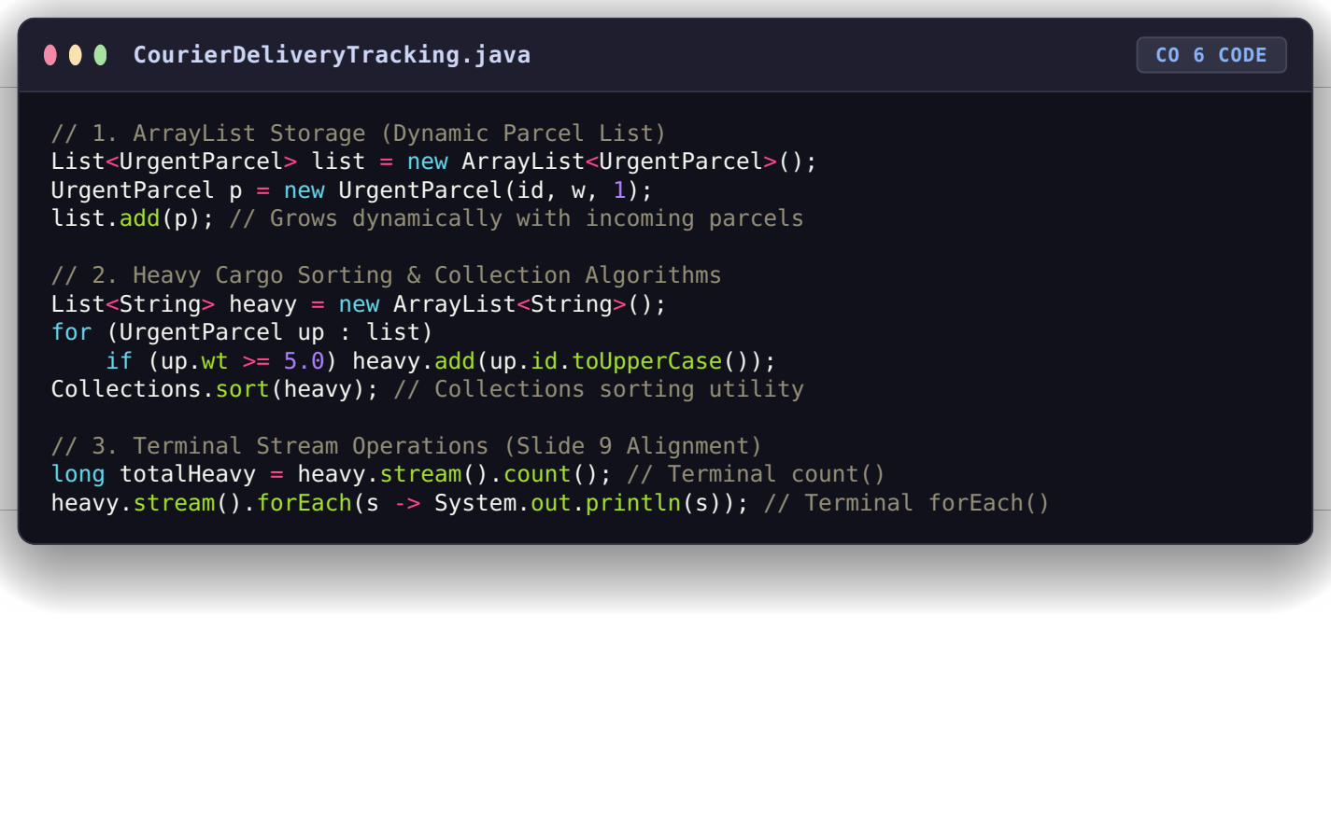
CO 6
ArrayList Storage:
  Holds UrgentParcel objects sequentially.
  Grows dynamically to handle unpredictable parcel booking volumes.
HashSet Filtering:
  Stores unique destination names ("HUB-X").
  Automatically drops duplicate records to keep transit lists clean.
Terminal Operations Only:
  count(): Extracts quick totals of registered cargo directly from the stream.
  forEach(): Prints tracking details cleanly without heavy, multi-line nested loops.

Slide 10
Conclusion
The Courier Delivery and Route Tracking System successfully brings together all six core Java programming outcomes into a unified management application. Moving away from long, cluttered main functions into a layout of specialized classes, recursive subroutines, and structured collection filters has vastly improved code maintenance and execution speeds. By combining 2-D array slot checking, persistent file writing via buffered streams, and built-in exception handling, this software provides a highly reliable digital solution to traditional logistics problems. This architecture successfully lowers manual tracking errors, handles runtime exceptions gracefully, and maintains highly reliable package manifests.

Slide 11
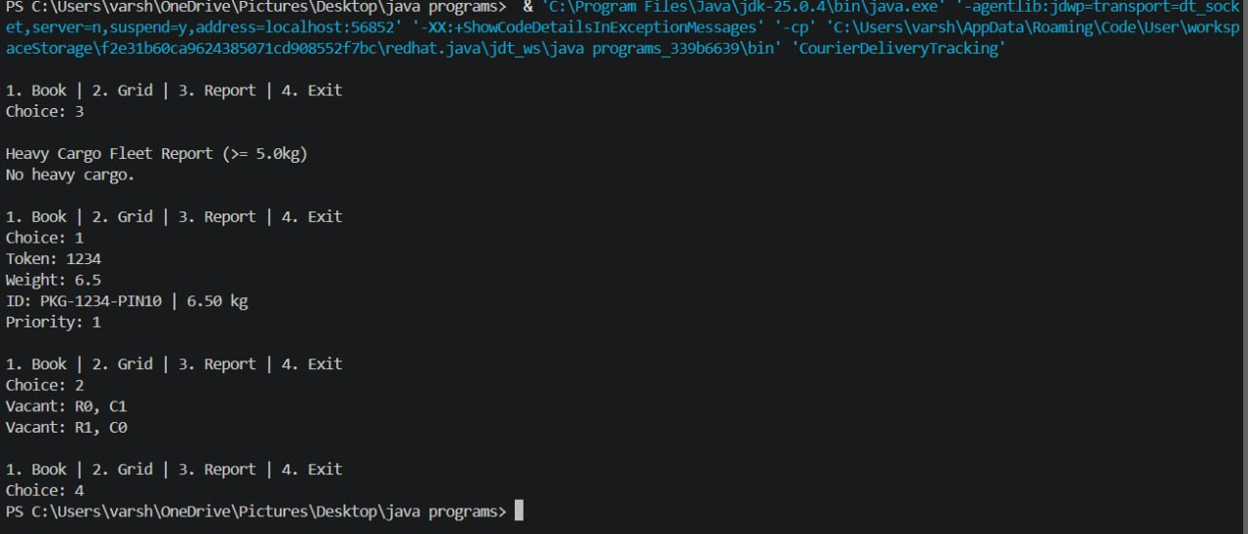
Screen Shots

Slide 12
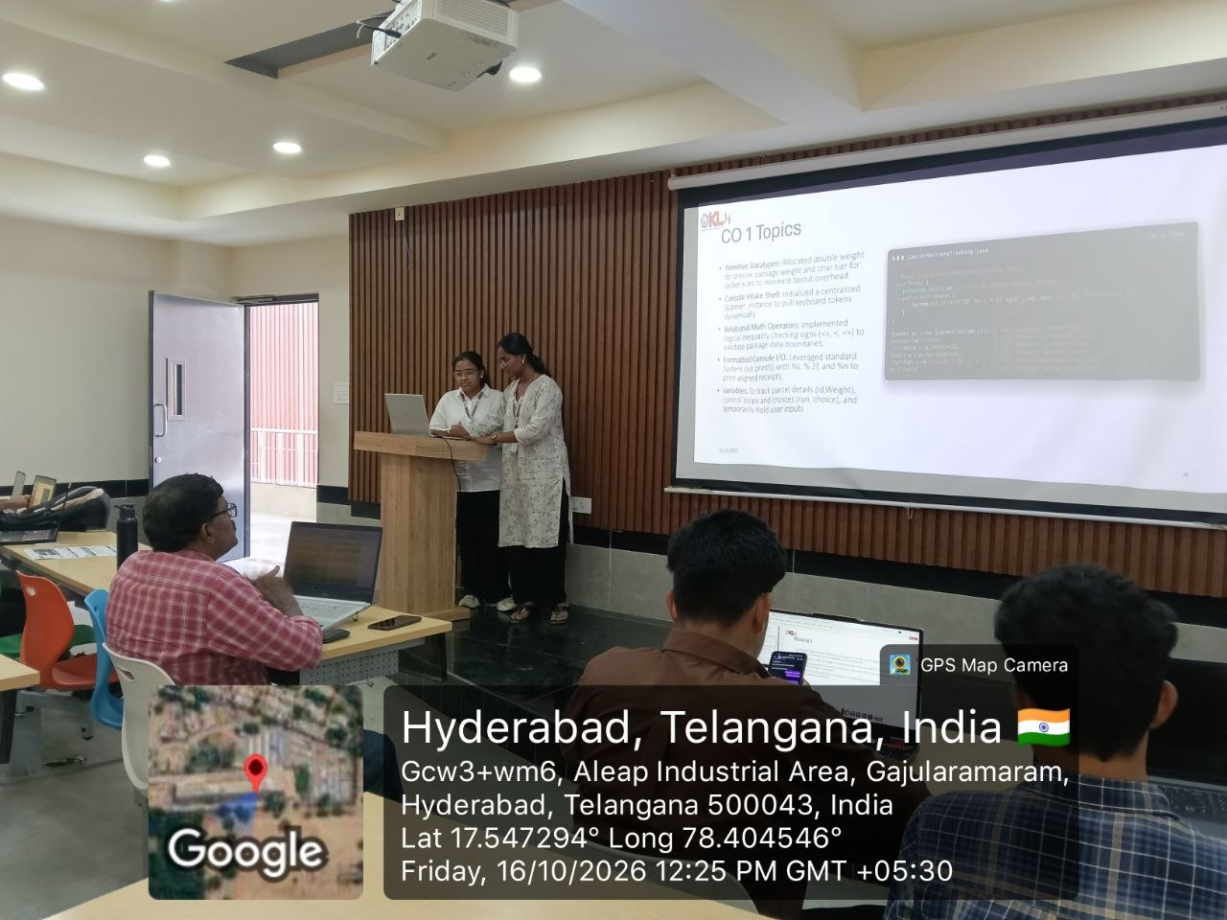
Geo Tag Photo and git hub link
GITHUB LINK: https://github.com/YVarshitaChowdary/Java-Project

